Slide 1
MongoDb and curd
Basic Collection Methods

Slide 2
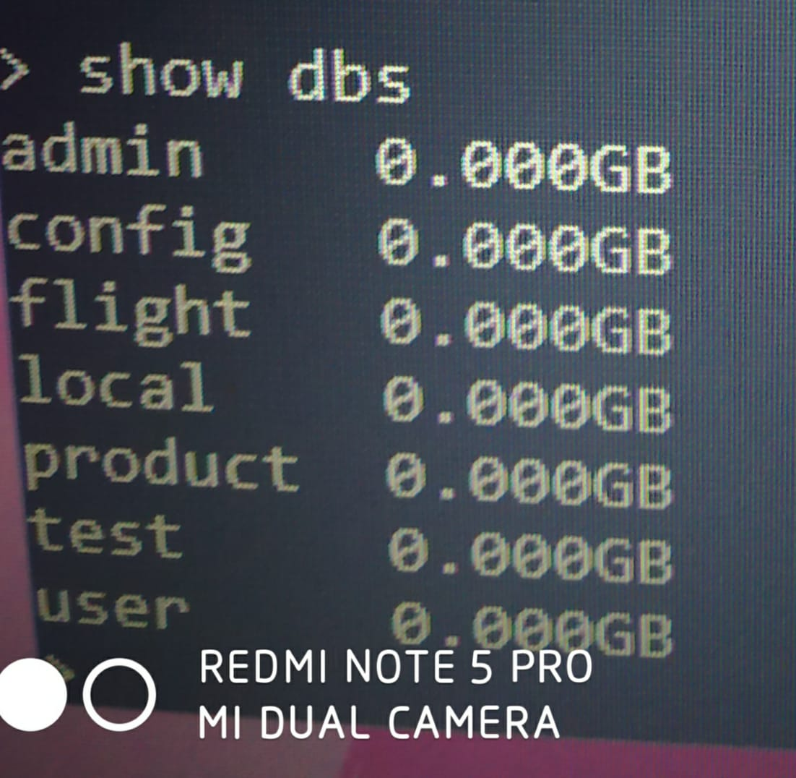
Show dbs

Slide 3
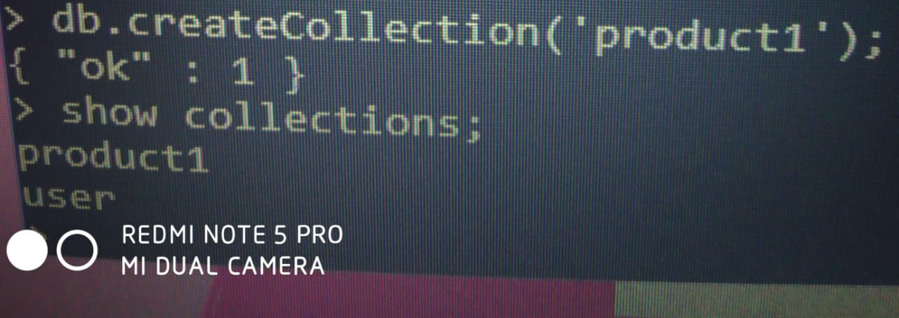
Create a database

Slide 4
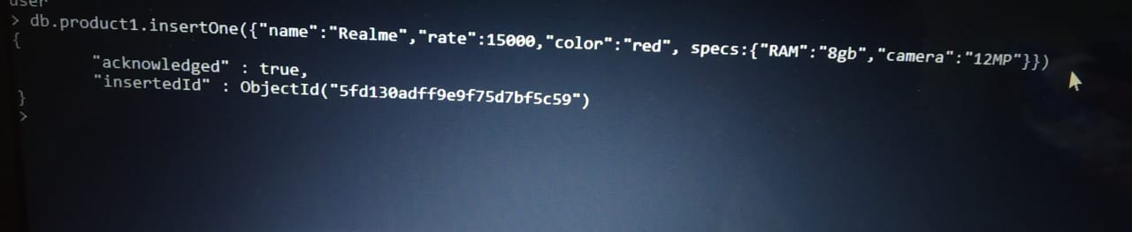
InsertOne Command

Slide 5
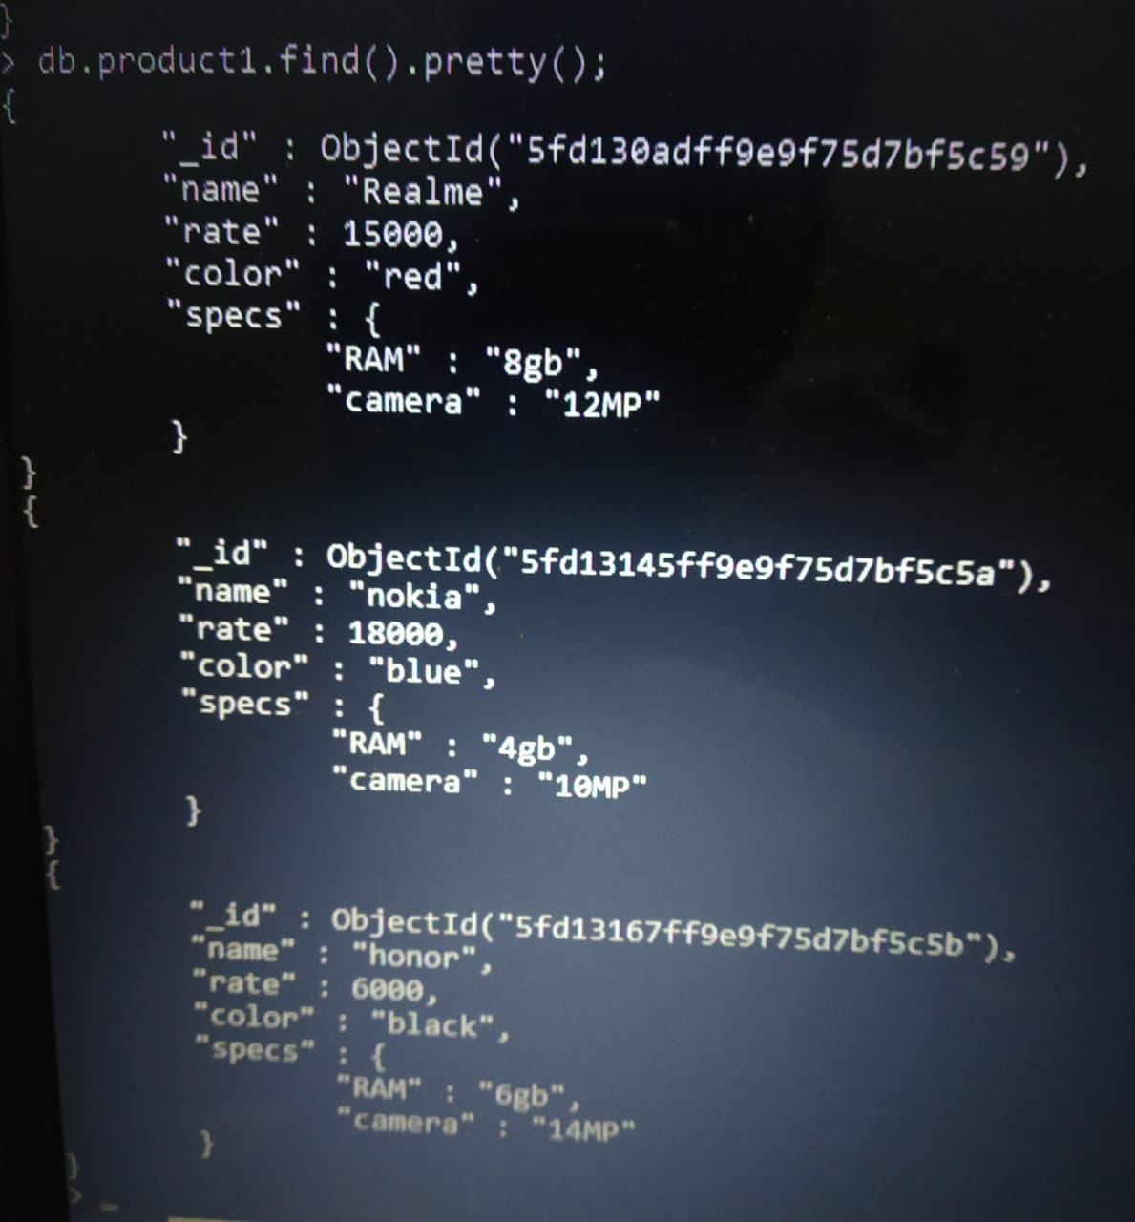
Read All

Slide 6
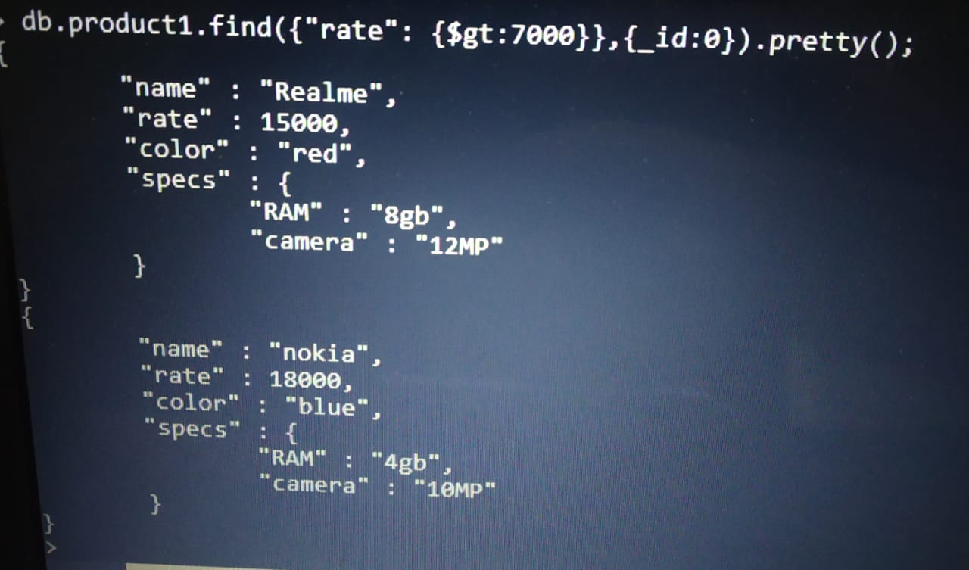
Read with condition and not printing _id

Slide 7
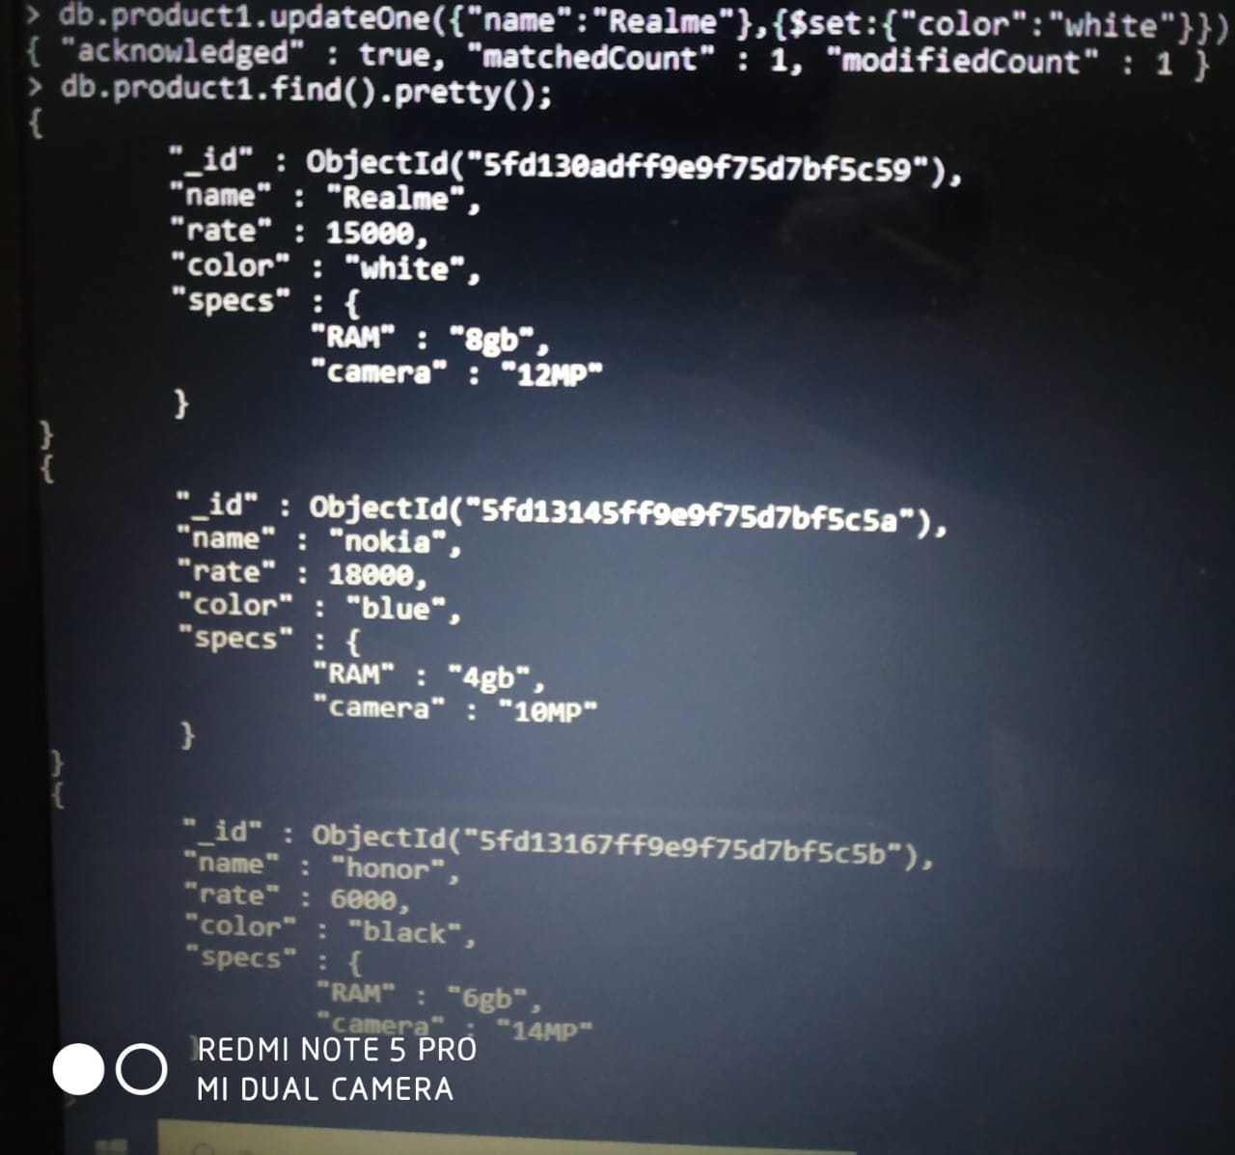
UpdateOne with condition

Slide 8
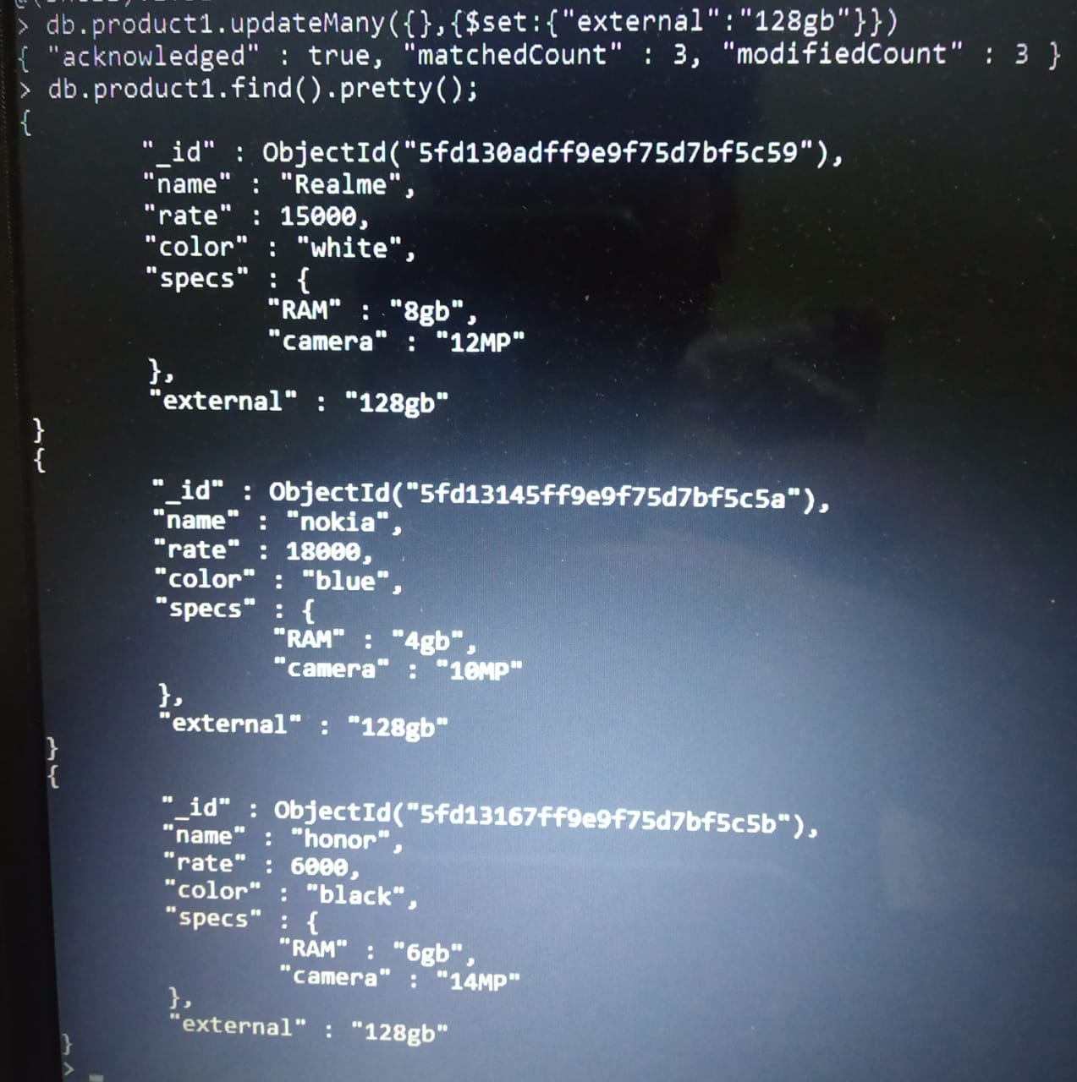
UpdateMany with condition

Slide 9
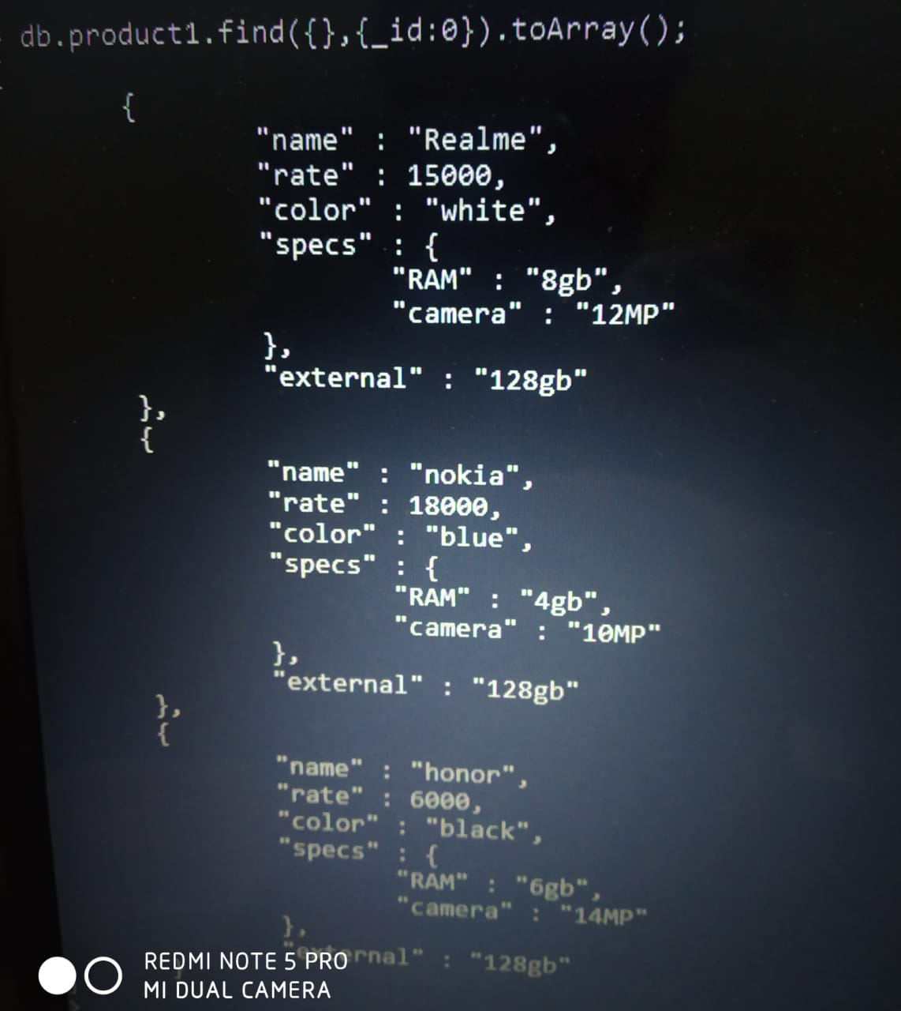
Display with toArray()

Slide 10
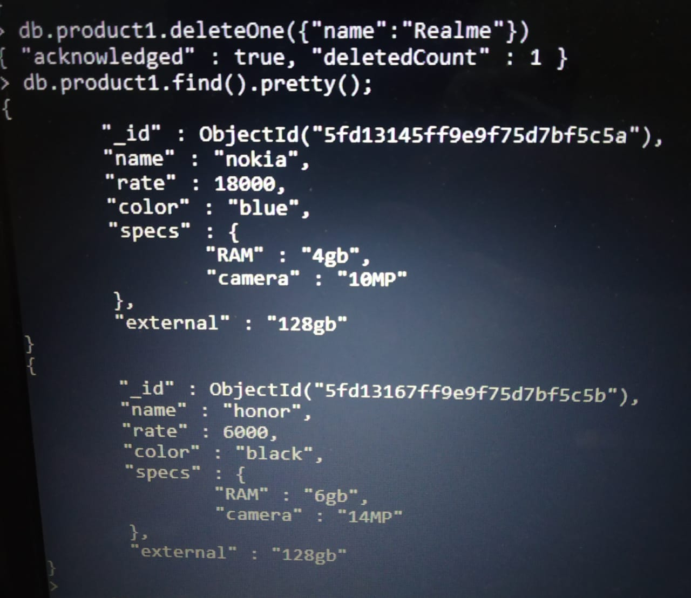
DeleteOne

Slide 11
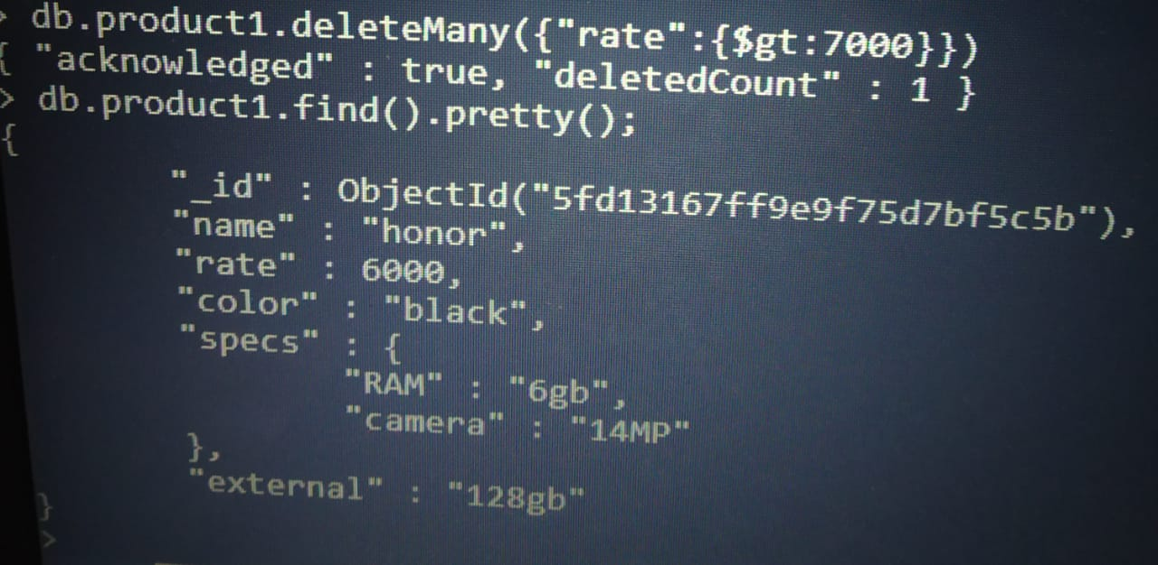
DeleteMany

Slide 12
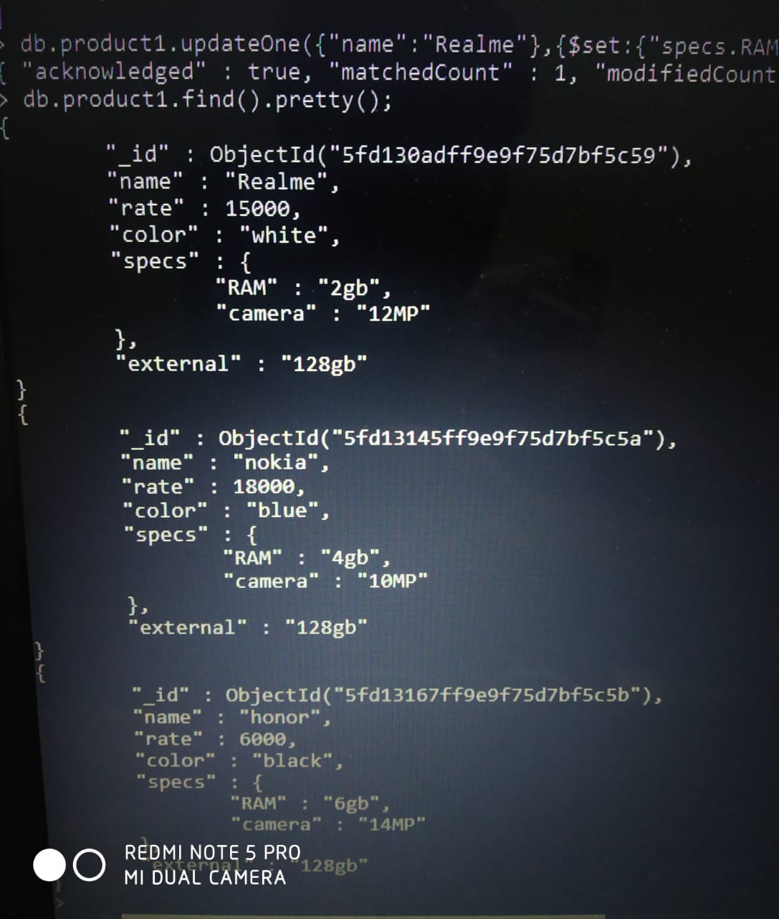
MultiLevel update

